Slide 1
Data Mining Cup 2017 Revenue Forecast of Mail Order Pharmacy
Final presentation
Data and Web Science Group
University of Mannheim
Alexander Brinkmann, Liane Gybas, Daniel Helfer, Nancy Kunath, Florian Schrage, Timo Sturm, Steffen Terheiden, Christoph Wagner
23.05.2017

Slide 2

Overview
Selection
Preprocessing
Transformation
Data Mining
Evaluation & Interpretation
Available data
…….
Target
Data
Preprocessed Data
Transformed Data
Patterns
Adopted from Fayyad et al. (1996)

Slide 3
DMC 17 - Challenge
Hier Informationen aus Kapitel 1 Report ???
Original task
Two step model
Adjusted two step model
Trend splitting model
Split data based on trend analysis
Predict the type of user action (Click/Basket =1 vs. Order =1)
Predict the type of user action (Click/Basket =1 vs. Order =1)
Predict the type of user action (Click/Basket =1 vs. Order =1)
Predict the revenue for every user action
Predict the quantity for all “order” actions
Predict the quantity/revenue for all “order” actions
Predict the revenue for all “order” actions
Evaluate result based on trend analysis
Regression problem
Classification problem
Trend analysis

Slide 4
Preprocessing
Selection
Preprocessing
Transformation
Data Mining
Evaluation & Interpretation
Available data
…….
Target
Data
Preprocessed Data
Transformed Data
Patterns
Adopted from Fayyad et al. (1996)

Slide 5
Feature Understanding and Engineering
Preprocessing – Feature Understanding/Engineering
Summary about our feature understanding steps:
analysed for missing values – e.g. competitorPrice
searched for outliers
Releted to specific field how: „pharmForm“ with 278 in 3-digit strings.
We interviewed a pharmacist, so we understand the policy of dosage codes and acronyms how e.g. „NTR“ = „Nasentropfen“
Sales index that was descriped in dispensing regulation codes
We analysied the correlation between the given attributes
Also we find out that 82 products were „always“ bougth.
In the other way we saw that 3100 products were never bought
And the import step for the dataset split after the 22nd day
Notes:
Outlier – 0 too low

Slide 6
Feature Understanding and Engineering
After analyzing the number of order, basket and click transactions, we discovered
that during the first 22 days of our training set the number of click transactions
was noticeably lower than during the following days.
Reasons for that may be for example different data creation processes. We decided to exclude these 22 days
Judgment of the Court (First Chamber - EuGH) of 19 October 2016:
Deutsche Parkinson Vereinigung eV vs Zentrale zur Bekämpfung unlauteren Wettbewerbs eV Setting of fixed prices for medicine, which are only available on prescription, is against European Law
Notes:
Outlier – 0 too low

Slide 7
Feature Understanding and Engineering
Preprocessing – Feature Understanding/Engineering
Summary about our feature engineering steps:
Mainly created with R and Python
in whole our final dataset holds 111 features
95 features based on transformation, combination, interpretation and with influence of external informations. (16 initial features)
use only16 initial features in the final approache = RMSE 9.747
After analyises with weight of GTB we reduced the final set to 44 features.
One of biggest performance improvement: we created a Basket feature based on groupig multiple user transactions.
Correlation values ???
With this feature it was possible if the basket was orderd or not
Highly imbalance training data: Recall 49.45% and precision 15.93% by using GTB.
Notes:
Outlier – 0 too low

Slide 8
Data Mining and Evaluation
Selection
Preprocessing
Transformation
Data Mining
Evaluation & Interpretation
Available data
…….
Target
Data
Preprocessed Data
Transformed Data
Patterns
Adopted from Fayyad et al. (1996)

Slide 9
Data Mining and Evaluation
Erklärung für Monate mit M1 – M3 und Starttag Sonntag im Oktober.
Notes:
Outlier – 0 too low

Slide 10
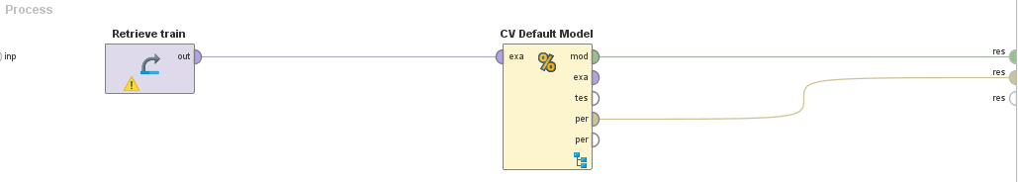
Data Mining and Evaluation
Baseline
Performance of the Default Model
Median: RMSE* = 10.904
Average: RMSE = 10.238
For comparison, basic Gradient Boosted Tree: RMSE = 9.679
*RMSE : Root Mean Squared Error
Notes:
Informations for the baseline

Slide 11
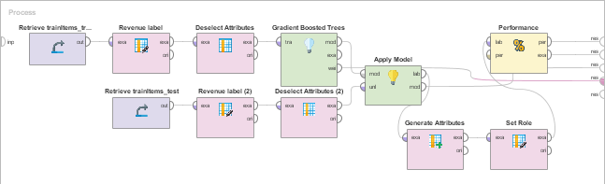
Data Mining and Evaluation
One-Step
Performance of the Default Model
Median: RMSE* = 9.161 by using GTB (Gradient Boosted Trees)
*RMSE : Root Mean Squared Error
Notes:
Informations for the baseline

Slide 12
Data Mining and Evaluation
One-Step
Definition des Aufbaus
Und Gründe warum wir diesen fokussiert haben
Aus dem Report:
Notes:
Outlier – 0 too low

Slide 13
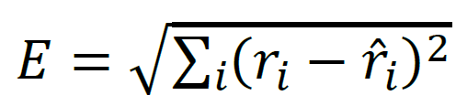
Data Mining and Evaluation
Evaluation takes place on example level
Difference between actual value and prediction is squared
Performance Measurement
Our result: E = 8.5xx

Slide 14
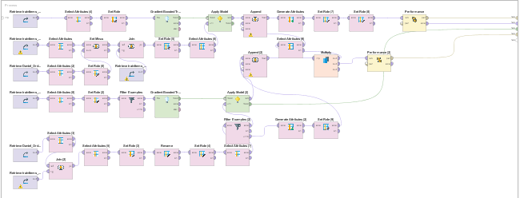
Data Mining and Evaluation
Two-Step
Performance of the Default Model
Median: RMSE* = 9.218 by using GTB (Gradient Boosted Trees) and including high confidence classification
*RMSE : Root Mean Squared Error
Notes:
Informations for the baseline

Slide 15
Data Mining and Evaluation
Two-Step
Definition des Aufbaus
Classification
Und Gründe warum wir diesen NICHT fokussiert haben
Aus dem Report:
Notes:
Outlier – 0 too low

Slide 16
Data Mining and Evaluation
Other approach sliding window
--- Bild fehlt noch
Performance of the Default Model
Median: RMSE* = 9.701 by using Sliding window
*RMSE : Root Mean Squared Error
Notes:
Informations for the baseline

Slide 17
Data Mining and Evaluation
Other Approach
Was war hier der Ansatz wenn wir rausfinden wollten
Notes:
Outlier – 0 too low

Slide 18
Summary and Lessons learned
Was haben wir gelernt?
Was haben wir alles verwendet?
Rapid Miner
Datenverständnis, Organisation in größeren Projektteams
Realworld Projektumsetzung
Python
R
Was hätten besser machen können?
Notes:
Outlier – 0 too low

Slide 19
Questions?
Feel free to ask!

Slide 20
Backup Slides
Slide mit R Code feature engineering?

Slide 21
Backup Slides – 44 Features
Basket_Size
rrp
productOrderRatio
manufacturer
price
group
DayTime
BasketPrice
basket_id
diff_rrp_price
basket_position
pharmForm
DayID
competitorPrice
weekday_name
priceNorm
weekday_number
priceCategory
differenceDailyPriceDifferenceCompetitorPriceDifference
Week
variance(price)
ratio_diff_rrp_competitorPrice_to_rrp
lineIDPerDay
day
priceMeanPriceVariance
diffPriceCompetitorPrice
dailyCompetitorPriceDifference
dailyPriceChange
dailyPriceDifference
ratioDiffPriceCompetitorPriceToPrice
ProductManufacturerRevenueRatio
GroupSizeSameProductAttributes
ratio_diff_rrp_price_to_rrp
quantityByPackage
ProductManufacturerOrderRatio
productOrderCounter
ratioDiffPriceCompetitorPriceToCompetitorPrice
productActionCounter
SameProductAttributes
pid
pharmFormGroup
dailyPriceFlexibility

Slide 22
Backup Slide
Hier evtl noch 2-3 Screenshots von Graphen Diagrammen etc ?

